Slide 1
Evaluation and adjustment of GEE timeseries analysis
July 6, 2018

Slide 2
Evaluating Timeseries Analysis

Slide 3
Timeseries Validation w Matopiba” in GEE:
Evaluate GEE Timeseries Analysis v7 using Matopiba planting/harvest data with “:
(NOTE that this file can only look at 2017, not the other years!)
In 2017, use 2017’s double cropping information to do a solid validation. Also validated the second crop’s peak timing and plant/harvest estimates.
Results of 2017 peak validation (i.e. is estimated peak between planting, harvest?)
For single crop: 38/39 validated
For double crop, first peak: 46/47 validated
For double crop, second peak: 32/34 validated

Slide 4
“Timeseries Validation of Quality mask” in GEE
Look at how different “second peak cutoff” dates affect how many pixels are masked out due to poor quality of estimations (quarter period too long or short; the two peaks in double cropped pixel are predicted too close together)
Vary the “second peak cutoff” date and see how the % masked changes with region (of Brazil) and with year. Maybe eventually pick the “second peak cutoff” that masks off the lowest number of pixels.
The results are tabulated in excel file called “Optimizing Timeseries Analysis Cutoff Date”
Note that if changing the “second peak cutoff” date doesn’t really change the performance, it means that the peak cutoff date choice isn’t the issue – more likely issue with classification map or EVI or scale is too big, etc. basically, if it doesn’t change, then it’s not an issue with the method itself – OR the within-region variation of appropriate cutoff date is large.
There should be some range over which change in cutoff date doesn’t really change performance, but then outside some reasonable range the performance should drop off (because very bad cutoff date choices should affect performance outside of misclassified pixels) – this is seen in the plots.
The max performance (i.e. the % pixels taken out with the best cutoff date) should be a good proxy for percent of misclassified pixels in a given region.
At cutoff of July 15, the number of good quality pixels falls to zero for all regions. This may be more due to the fact that we only have 15 days left of information to fit; perhaps in some regions ending the data at July 31 is cutting off a lot of the second peak. Look at timeseries in region 5,4, 3 to confirm.

Slide 5
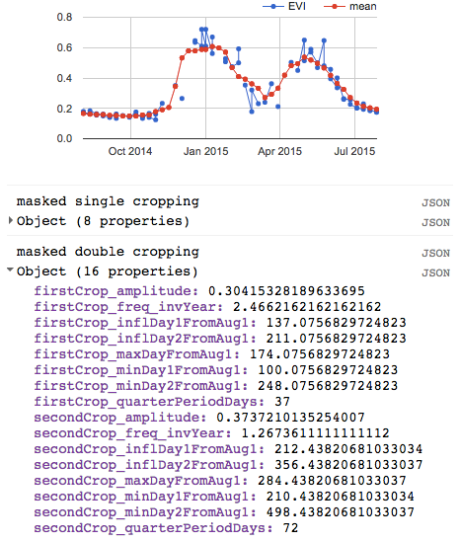
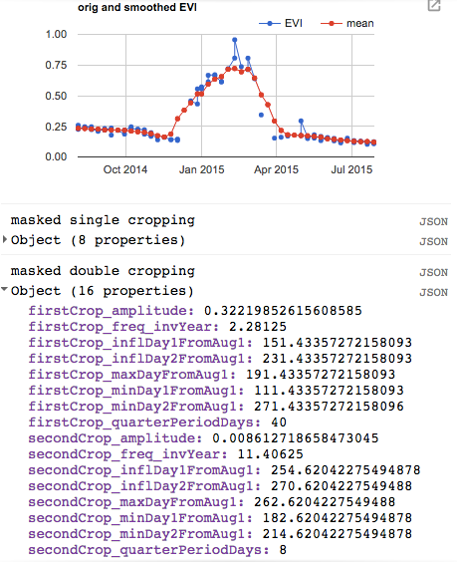
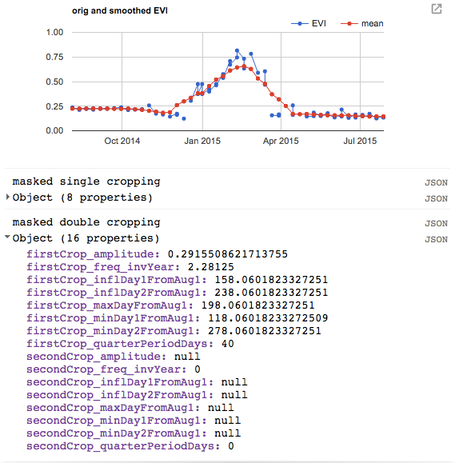
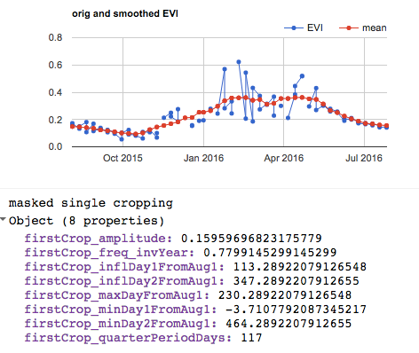
Examples of low quality estimations due to land misclassification:
Note that if the EVI looks like single cropping but we still try to calculate a second peak, sometimes it will return a frequency of zero, and therefore max peak day, etc as null. This is one way we can separate the single vs double cropping pixels that are actually classified as double cropped. also need to look at space between predicted first and second peaks, and quarter period to pin single cropped pixels that are misclassified as double cropping.
If the pixel is natural vegetation, the quarter period will be very long

Slide 6
Results of Timeseries Validation of Quality mask

Slide 7
“Timeseries Produce Final Asset” in GEE
Combine all single, double crop images from all years into a single image with bands for each year’s peak time and quarter period
Combine all single, double crop images from all years into a single image with bands for quality (good or bad quality estimations)

Slide 8
GitHub and GEE

Slide 9
GitHub and GEE
My account: minghuiz@berkeley.edu
Commit GEE files to GitHub:
click on the gear icon next to the folder in GEE
navigate to ‘crop_timing’ folder in my computer (or whatever file I want to add the scripts to)
copy paste the ‘git clone’ command into terminal
had to copy paste something from googlesource site for password – found the link to it through https://developers.google.com/earth-engine/playground
then, do the regular:
Do git status to see new changes;
Do git add –A or git add (filename) to add the file to the “tracking” staging area/repository
Do git commit –m ‘message’ to describe changes made to the file
Do git push to add to GitHub

Slide 10
To Do

Slide 11
i think it’d be neat to see some summary stats and visualizations of your findings. i’m curious about variation within municipality-years over grid cells, variation over time at a municipality and broader scale patterns too. could you make some tables/figures/histograms, post them to drive and add links to and discussion of these items in the readme on Github?

Slide 12
To Do – LAI timeseries
Overlay the Matopiba/rally points with Land cover class in Mapbiomas and CAR field polygon data so we know that the LAI info was taken for an actual soy point rather than a road, etc. Jake will give me CAR polys – area explorada (which has managed regions only) – overlay this with Matopiba data points to see if the ones in area explorada have LAI values that make more sense. Match up Matopiba and CARpolys by farmer name
See if Dave or Jake can upload GOME data. See if Avery gets STAIR information.
as soon as the LC is updated, write up a one pager explaining and justifying the approach and showing summary stats, visualizations, and validation (e..g with the matopiba survey data on planting date and harvest date). if all looks good, then great. otherwise, the next step might be to work on improvements
explore an approach that lets you use some goodness of fit type metric to let you select your frequency parameter in your harmonic curve fitting scheme.
Export Matopiba planting/harvest date data using GEE
Look at Gabriel’s paper to relate planting date to emergence
Put in GEE a way to get a sense of the spread in planting, harvest dates and how different pixels look from each other
Fit planting date to onset map for running hypothetical pixels. Ask for onset map from Gabriel.
Approximate peak LAI using change in onset. (ask Gabriel for onset map? Or did he send it already?)
For validating plant/harvest dates with Matopiba, maybe try a bunch of different plant/harvest date estimates to come up with an estimated range, then compare the overlap of the estimated range with the reported range

Slide 13
Tasks – from Zoho
Mask of single/double cropped areas – pick the Morgen class for the Rally pixels so Gabriel can see how they relate to onset-greenup
Soy classification maps: Obtain all relevant soymaps and decide on combining maps if necessary. overlay Pequisa agri municipal data as a “check”
Determine representativeness of yield data
Sample new soy pixels
Phenology calculations (planting, harvest estimates) for all sampled soy pixels
Going Forward
Think about paper on plant/harvest date. Will it be a methods paper (RS? Hydrology? Agri?) or application paper?
For qual, propose the following: (1) plant/harvest date estimation, (2) analyzing plant/harvest date estimation as proxy for farmer behavior over history, (3) something with the statistical crop model.

